Slide 1


Please attribute as SimpleITK Fundamental Concepts
This work is copyrighted by the NumFOCUS
It is distributed under a Creative Commons Attribution 4.0 International License: https://creativecommons.org/licenses/by/4.0/

Slide 2
SimpleITK Fundamental Concepts
With a Solid Foundation
The Sky is the Limit
Marina Torch Tower in Dubai (Wikimedia commons Creative Commons Attribution-Share Alike 3.0 Unported).

Slide 3
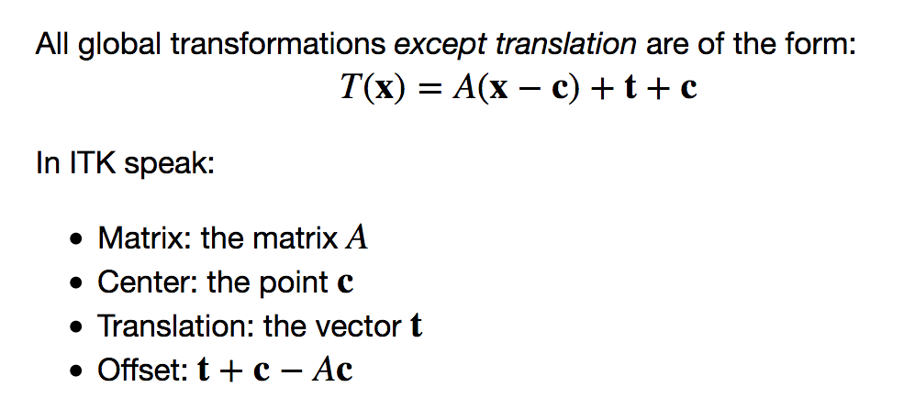
Transforms
Transforms Images Resampling Registration
All global domain transformation are of the form*:
*Except translation.

Slide 4
Transforms
Transforms Images Resampling Registration
Free-Form Deformation (local domain):
sparse grid of control points with uniform spacing,
B_{0..3}
cubic B-spline basis functions.
You set:
Spline order (default is cubic)
Number of grid points per axis (mesh size)
Spatial domain manually: origin; physical dimension; direction cosine matrix image based: BSplineTransformInitializerFilter
Transformation is identity outside the user defined domain.

Slide 5
Transforms
Transforms Images Resampling Registration
Displacement Field (local domain):
Dense set of vectors representing the displacement in a given spatial domain.
You set:
Spatial domain and deformation: manually: origin; physical dimension; direction cosine matrix; vector values. image based: vector image which is emptied of its contents.
Transformation is identity outside the user defined domain.

Slide 6
Transforms
Transforms Images Resampling Registration
Composite transformation:
Represents multiple transformations applied one after the other. T₀(T₁(T₂(…T_{n}(p)...)))
Stack based semantics – first in last applied. composite_transform = sitk.Transform([T_{0,}T₁]) composite_transform.AddTransform(T₂)
When used as the optimized transformation in registration (SetInitialTransform), only the parameters of the last transformation, T_{n}, are optimized.

Slide 7
Images
Transforms Images Resampling Registration
An image is defined by:
Pixel type + spatial dimensionality.
Physical region in space occupied by the image as specified by: origin, spacing, size, and direction cosine matrix.

Slide 8
Images
Transforms Images Resampling Registration
Exactly the same intensities, but in a different physical location.

Slide 9
Images
Transforms Images Resampling Registration
Most non-medical image viewers do not support an-isotropic image spacing:

Slide 10
Images
Transforms Images Resampling Registration
SimpleITK2Numpy:
sitk.GetArrayFromImage – Data copied into numpy array (mutable).
sitk.GetArrayViewFromImage – numpy array view of image data (immutable).
Numpy2SimpleITK:
Copy bulk pixel data into SimpleITK image: new_image = sitk.GetImageFromArray
Set all of the parameters defining the physical region in space:
new_image.CopyInformation
or
new_image.SetOrigin, new_image.SetSpacing, new_image.SetDirection
Caution: If the SimpleITK image is released the array view memory is no longer valid.

Slide 11


Resample: Image + Transform
Transforms Images Resampling Registration
f
m
Resampling, three elements (assuming arbitrary interpolation method):
Image – the image we resample in coordinate system m.
transformation – T(^{f}p) = ^{m}p maps points from coordinate system f to m.
resampling grid – uniform set of points which will be mapped by the transformation.

Slide 12
Resample: Image + Transform
Transforms Images Resampling Registration
f
m
Specifying the resampling grid
Use an existing image.
Use origin, size, spacing, and direction cosine.
Unexpected results: errors in resampling grid specification or transformation.

Slide 13
Registration – Coordinate Systems
Transforms Images Resampling Registration
Three coordinate systems: Fixed, Virtual, Moving.
Three transformations: T_{f}(^{v}p) = ^{f}p
T_{m}(^{v}p) = ^{m}p
T_{opt}(^{m}p) = ^{m}p’
Most often T_{f}=I, the fixed and virtual coordinate systems coincide.

Slide 14
Registration - Framework
Transforms Images Resampling Registration
Optimizers:
Exhaustive
Nelder-Mead Simplex/Amoeba
Powell
1+1 evolutionary
GradientDescent GradientDescentLineSearch RegularStepGradientDescent
ConjugateGradientLineSearch
L-BFGS-B
L-BFGS-2
Similarity metrics:
MeanSquares Demons Correlation ANTSNeighborhoodCorrelation JointHistogramMutualInformation MattesMutualInformation
Multi-resolution framework.
Masks.
Sampling strategies (NONE, REGULAR, RANDOM).

Slide 15
Registration – Implementing Your Own
Transforms Images Resampling Registration
Look for a similar example in the notebooks repository.
Start from scratch, start simple (i.e. single scale).
Modify the registration settings by observing the similarity metric value during the iterations using a tight bound on the number of iterations. Modify till you observe desired behavior: (i) consistent reduction in similarity metric value (ii) in an appropriate timely manner.*
* plotting similarity metric value often takes longer than the registration, remove it when done.

Slide 16
Registration – Implementing Your Own
Transforms Images Resampling Registration
Points to note:
Initialization - Use domain knowledge, corresponding structures should have some degree of overlap after initialization.
For the global transformations, SetOptimizerScalesFromPhysicalShift is required as the parameters are not commensurate (except for translation).
Sampling - Random and uniform sampling reduce computation time.
Similarity metric – problem dependent, *MutualInformation most generic, MeanSquares most specific and rather limited.
Use masks to specify ROI. If small mask in large image, change to a cropped image without a mask.
Optimizers - *Gradient* - best suited for global transformations with small number of parameters. L-BFGS-B use for BSplineTransform, large number of parameters.

Slide 17
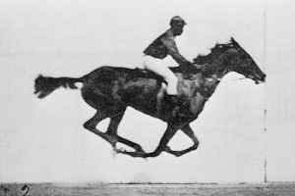
Let’s start the tutorial,
off to the races we go:
Wikimedia commons, public domain, race horse filmed by Edward Muybridge 1878.

